Slide 1
Prediction of target SLAs are met within businesses
Presented by
Isuri Chandrasekera

Slide 2
BIO
Profile and Portfolio
Experience in Retail IT for over 15 years.
Experience in both Large and small scale Retail
Exposure to Data Science
Education
Bachelor of Information Technology (Computer Science and Software Development) – Deakin University (2009)
CCNA 1 to 1V Certification (WAN Technologies, Switching Basics and intermediate Routing, Router and Routing Basics, Networking Basics)
SQL SERVER 2008 for Business Intelligence

Slide 3
Agenda
Business Problem
Exploring data analysis
Project pipeline
Model evaluation
Conclusion

Slide 4
Overview
Most businesses profitability relies on Target SLAs.
Making data driven decisions affects all identified five core business systems such as,
Sales & Marketing.
Quality & Product/Service Delivery.
Product Development.
Accounting & Technology.
Administrative (Management, HR & Finance)
Provides an assurance that the seller can respond to a customer query within a given time period.
Allows to highlight where the system needs further data to have a complete picture of the business

Slide 5
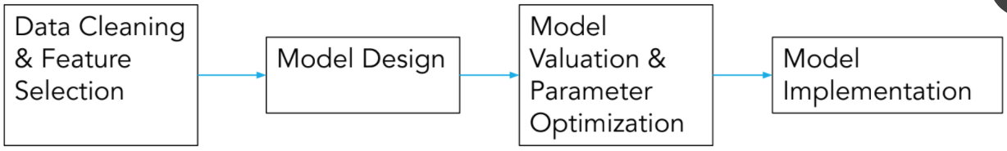
Project pipeline
141,712 rows x 36 features
Logistic Regression
Support Vector Classifier
Decision Tree
Random Forest
Gaussian Naive Bayes
CatBoostClassifier
Select best model
& tuning parameters
Split data into
70% train – 30%
test

Slide 6
Incident management process enriched event log
Answering the question
‘What affects a new case?’

Slide 7
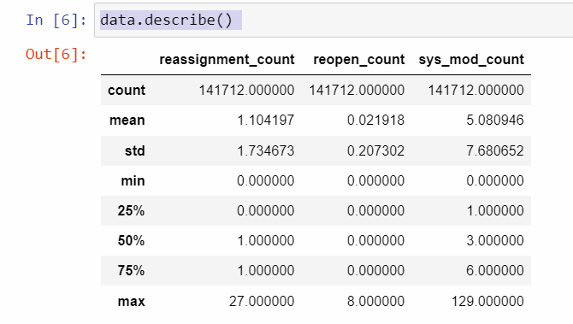
Summery of the data frame
By default, describe() computes and only shows statistics for the numeric variables.
count
mean
standard deviation
the minimum and maximum
the 25th, 50th, and 75th percentiles

Slide 8
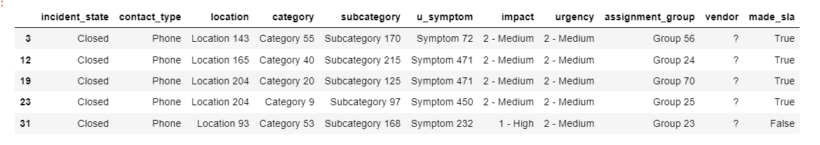
All columns known as a new job and prediction variable.

Slide 9
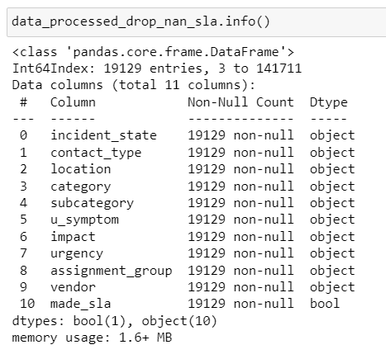
Exploring the filtered dataset

Slide 10
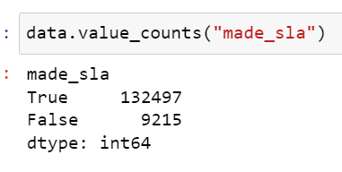
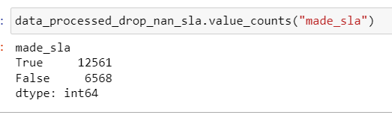
Data is lost due to filtering, it is ignorable.
Before | After

Slide 11
Understanding the dataset and identifying what to expect
incident within the target SLA | identified as exceeded | True Positive
incident within the target SLA | not identified as exceeded | True Negative
incident exceeded the target SLA | identified as exceeded | False Positive
incident exceeded the target SLA | not identified as exceeded | False negative

Slide 12
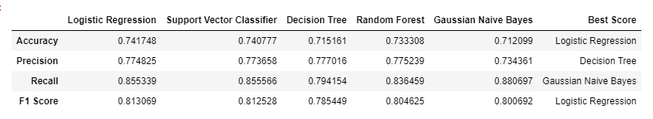
Relatively F1 Score is high and the accuracy is high in Random Forrest F1 Score is best if there is some sort of balance between precision (p) & recall (r) in the system

Slide 13
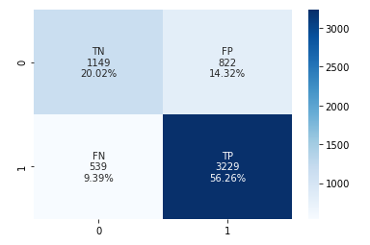
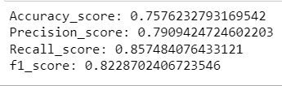
CatBoost Classifier

Slide 14
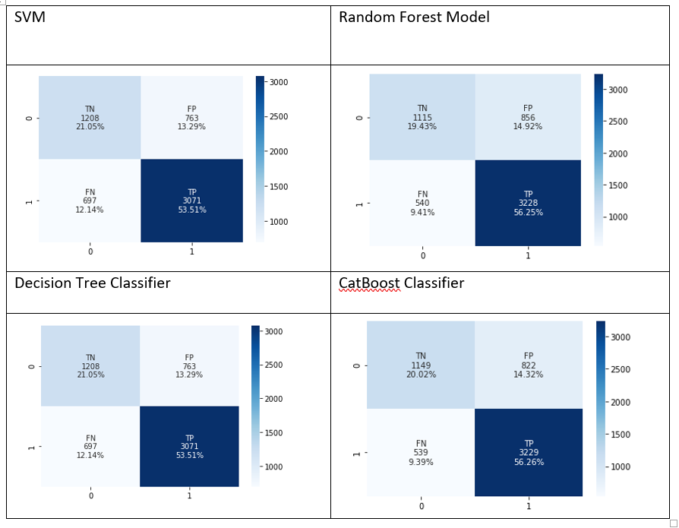
Confusion Matrix for other classifiers.

Slide 15
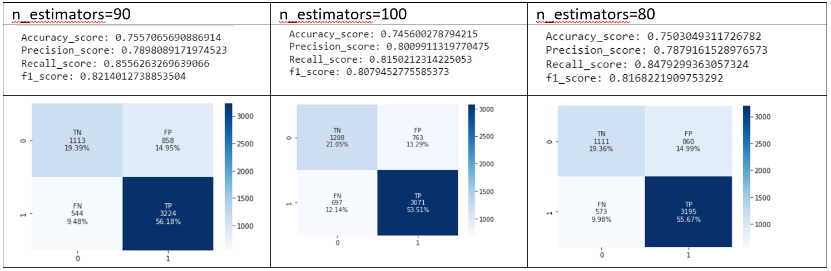
Random Forest Model (Gaussian Classifier) n_estimators=90 did the best of all three as it provided 9.48% for FN. It also shows a relatively higher Accuracy score.

Slide 16
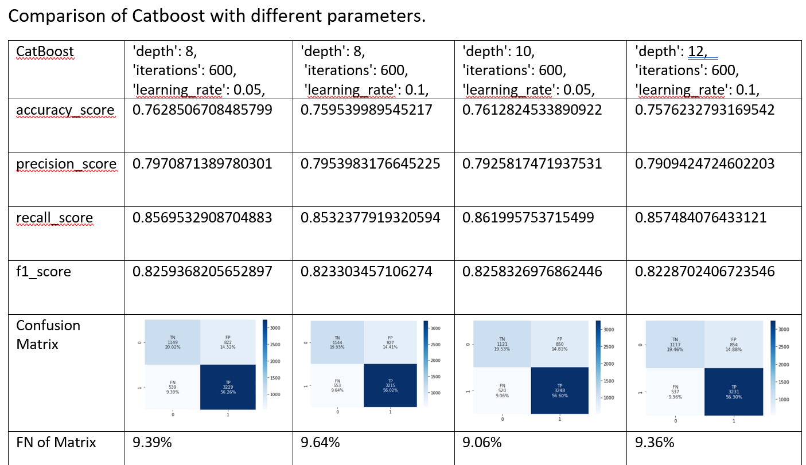

Slide 17
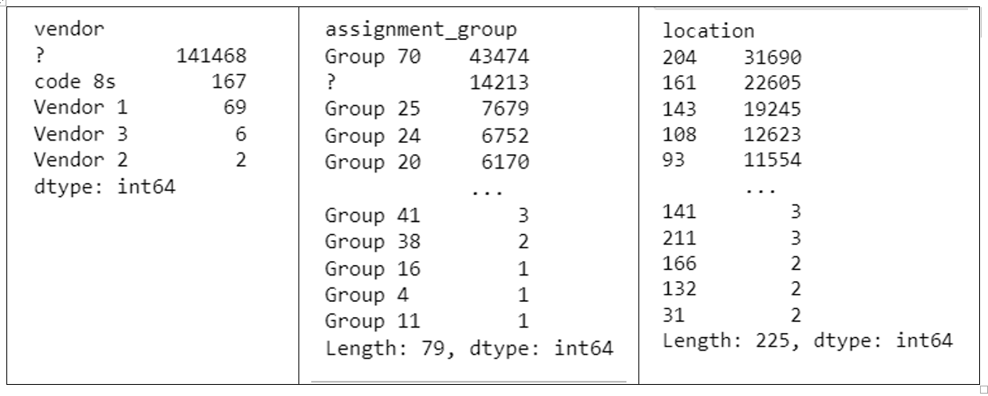
Further assessing the dataset majority of details are missing Data comparison of Vendor, Assignment group and Location

Slide 18
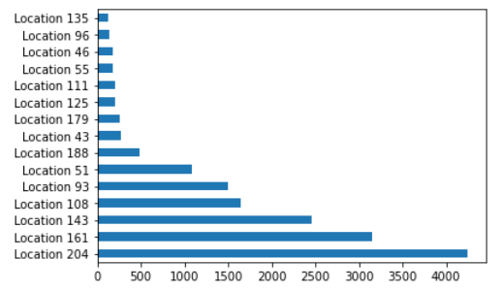
Location, Category and Group VS value counts
There are six locations clearly indicating that it is more likely to generate a new case.

Slide 19
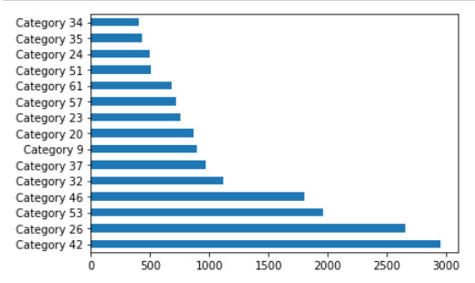
Location, Category and Group VS value counts
Categories 46, 53, 26, and 42 seems to be more popular compared to rest of the categories.

Slide 20
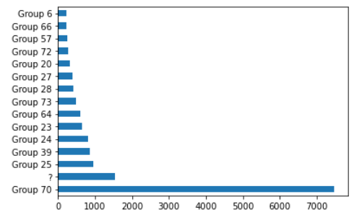
Location, Category and Group VS value counts
This graph clearly indicates that Group 70 is the busiest group out of all.
It also shows that a big percentage of group information is not entered.

Slide 21
Conclusion.
Recording and training data and identifying further needed data can optimise most customer-oriented businesses to their best.
Target SLAs can be met and what can be further done to reach a business’s optimal goal, can be predicted
Given example dataset indicated that CatBoost is the best training classifier to predict its Target SLAs.

